Slide 1


The Mole
Chemistry I HD – Chapter 6
Chemistry I – Chapter 10
ICP - Handouts
SAVE PAPER AND INK!!! When you print out the notes on PowerPoint, print "Handouts" instead of "Slides" in the print setup. Also, turn off the backgrounds (Tools>Options>Print>UNcheck "Background Printing")!
6.02 X 10²³
Notes:
To play the movies and simulations included, view the presentation in Slide Show Mode.

Slide 2
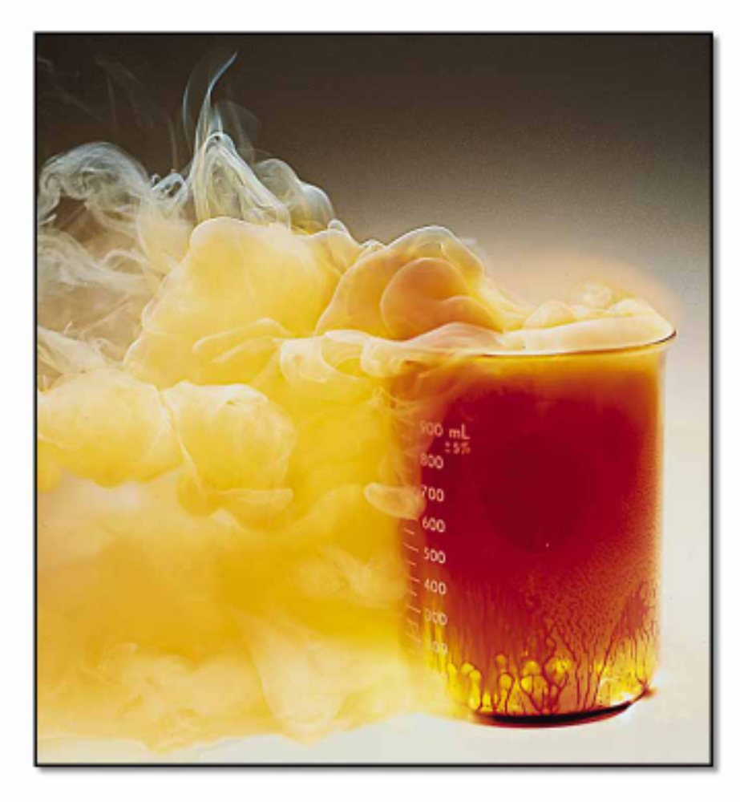
STOICHIOMETRY
- the study of the quantitative aspects of chemical reactions.

Slide 3
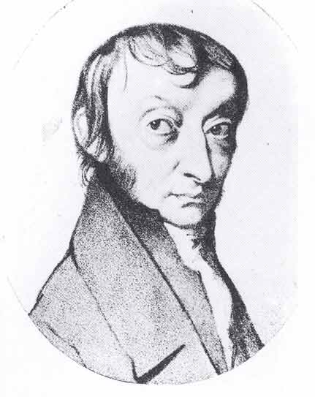
The Mole
A counting unit
Similar to a dozen, except instead of 12, it’s 602 billion trillion 602,000,000,000,000,000,000,000
6.02 X 10²³ (in scientific notation)
This number is named in honor of Amedeo _________ (1776 – 1856), who studied quantities of gases and discovered that no matter what the gas was, there were the same number of molecules present

Slide 4

Just How Big is a Mole?
Enough soft drink cans to cover the surface of the earth to a depth of over 200 miles.
If you had Avogadro's number of unpopped popcorn kernels, and spread them across the United States of America, the country would be covered in popcorn to a depth of over 9 miles.
If we were able to count atoms at the rate of 10 million per second, it would take about 2 billion years to count the atoms in one mole.

Slide 5
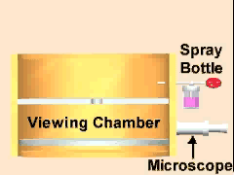
Everybody Has Avogadro’s Number!
But Where Did it Come From?
It was NOT just picked! It was MEASURED.
One of the better methods of measuring this number was the Millikan Oil Drop Experiment
Since then we have found even better ways of measuring using x-ray technology

Slide 6
Learning Check
Suppose we invented a new collection unit called a rapp. One rapp contains 8 objects.
1. How many paper clips in 1 rapp?
a) 1 b) 4 c) 8
2. How many oranges in 2.0 rapp?
a) 4 b) 8 c) 16
3. How many rapps contain 40 gummy bears?
a) 5 b) 10 c) 20

Slide 7
The Mole
1 dozen cookies = 12 cookies
1 mole of cookies = 6.02 X 10²³ cookies
1 dozen cars = 12 cars
1 mole of cars = 6.02 X 10²³ cars
1 dozen Al atoms = 12 Al atoms
1 mole of Al atoms = 6.02 X 10²³ atoms
Note that the NUMBER is always the same, but the MASS is very different!
Mole is abbreviated mol (gee, that’s a lot quicker to write, huh?)

Slide 8
A Mole of Particles
Contains 6.02 x 10²³ particles
= 6.02 x 10²³ C atoms
= 6.02 x 10²³ H₂O molecules
= 6.02 x 10²³ NaCl “molecules”
(technically, ionics are compounds not molecules so they are called formula units)
6.02 x 10²³ Na⁺ ions and
6.02 x 10²³ Cl– ions
1 mole C
1 mole H₂O
1 mole NaCl

Slide 9
Avogadro’s Number as Conversion Factor
6.02 x 10²³ particles
1 mole
or
1 mole
6.02 x 10²³ particles
Note that a particle could be an atom OR a molecule!

Slide 10

Learning Check
1. Number of atoms in 0.500 mole of Al
a) 500 Al atoms
b) 6.02 x 10²³ Al atoms
c) 3.01 x 10²³ Al atoms
2.Number of moles of S in 1.8 x 10²⁴ S atoms
a) 1.0 mole S atoms
b) 3.0 mole S atoms
c) 1.1 x 10⁴⁸ mole S atoms

Slide 11
Molar Mass
The Mass of 1 mole (in grams)
Equal to the numerical value of the average atomic mass (get from periodic table)
1 mole of C atoms = 12.0 g
1 mole of Mg atoms = 24.3 g
1 mole of Cu atoms = 63.5 g

Slide 12
Other Names Related to Molar Mass
Molecular Mass/Molecular Weight: If you have a single molecule, mass is measured in amu’s instead of grams. But, the molecular mass/weight is the same numerical value as 1 mole of molecules. Only the units are different. (This is the beauty of Avogadro’s Number!)
Formula Mass/Formula Weight: Same goes for compounds. But again, the numerical value is the same. Only the units are different.
THE POINT: You may hear all of these terms which mean the SAME NUMBER… just different units

Slide 13
Learning Check!
Find the molar mass
(usually we round to the tenths place)
1 mole of Br atoms
1 mole of Sn atoms
= 79.9 g/mole
= 118.7 g/mole

Slide 14
Molar Mass of Molecules and Compounds
Mass in grams of 1 mole equal numerically to the sum of the atomic masses
1 mole of CaCl₂ = 111.1 g/mol
1 mole Ca x 40.1 g/mol
+ 2 moles Cl x 35.5 g/mol = 111.1 g/mol CaCl₂
1 mole of N₂O₄ = 92.0 g/mol

Slide 15
Learning Check!
Molar Mass of K₂O = ? Grams/mole
B. Molar Mass of antacid Al(OH)₃ = ? Grams/mole

Slide 16
Learning Check
Prozac, C₁₇H₁₈F₃NO, is a widely used antidepressant that inhibits the uptake of serotonin by the brain. Find its molar mass.

Slide 17
Calculations with Molar Mass
molar mass
Grams Moles

Slide 18

Converting Moles and Grams
Aluminum is often used for the structure of light-weight bicycle frames. How many grams of Al are in 3.00 moles of Al?
3.00 moles Al ? g Al

Slide 19
1. Molar mass of Al 1 mole Al = 27.0 g Al
2. Conversion factors for Al
27.0g Al or 1 mol Al
1 mol Al 27.0 g Al
3. Setup 3.00 moles Al x 27.0 g Al
1 mole Al
Answer = 81.0 g Al

Slide 20

Learning Check!
The artificial sweetener aspartame (Nutra-Sweet) formula C₁₄H₁₈N₂O₅ is used to sweeten diet foods, coffee and soft drinks. How many moles of aspartame are present in 225 g of aspartame?

Slide 21
Atoms/Molecules and Grams
Since 6.02 X 10²³ particles = 1 mole AND
1 mole = molar mass (grams)
You can convert atoms/molecules to moles and then moles to grams! (Two step process)
You can’t go directly from atoms to grams!!!! You MUST go thru MOLES.
That’s like asking 2 dozen cookies weigh how many ounces if 1 cookie weighs 4 oz? You have to convert to dozen first!

Slide 22
Calculations
molar mass Avogadro’s number
Grams Moles particles
Everything must go through Moles!!!

Slide 23

Atoms/Molecules and Grams
How many atoms of Cu are present in 35.4 g of Cu?
35.4 g Cu 1 mol Cu 6.02 X 10²³ atoms Cu
63.5 g Cu 1 mol Cu
= 3.4 X 10²³ atoms Cu

Slide 24
Learning Check!
How many atoms of K are present in 78.4 g of K?

Slide 25
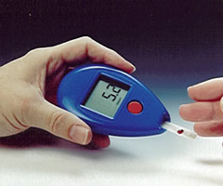
Learning Check!
What is the mass (in grams) of 1.20 X 10²⁴ molecules of glucose (C₆H₁₂O₆)?

Slide 26
Learning Check!
How many atoms of O are present in 78.1 g of oxygen?
78.1 g O₂ 1 mol O₂ 6.02 X 10²³ molecules O₂ 2 atoms O
32.0 g O₂ 1 mol O₂ 1 molecule O₂

Slide 27

Percent Composition
What is the percent carbon in C₅H₈NO₄ (the glutamic acid used to make MSG monosodium glutamate), a compound used to flavor foods and tenderize meats?
a) 8.22 %C
b) 24.3 %C
c) 41.1 %C

Slide 28
Chemical Formulas of Compounds
(HONORS only)
Formulas give the relative numbers of atoms or moles of each element in a formula unit - always a whole number ratio (the law of definite proportions).
NO₂ 2 atoms of O for every 1 atom of N
1 mole of NO₂ : 2 moles of O atoms to every 1 mole of N atoms
If we know or can determine the relative number of moles of each element in a compound, we can determine a formula for the compound.

Slide 29
Types of Formulas
(HONORS only)
Empirical Formula
The formula of a compound that expresses the smallest whole number ratio of the atoms present.
Ionic formula are always empirical formula
Molecular Formula
The formula that states the actual number of each kind of atom found in one molecule of the compound.

Slide 30
To obtain an Empirical Formula (HONORS only)
1. Determine the mass in grams of each element present, if necessary.
2. Calculate the number of moles of each element.
3. Divide each by the smallest number of moles to obtain the simplest whole number ratio.
If whole numbers are not obtained* in step 3), multiply through by the smallest number that will give all whole numbers
* Be careful! Do not round off numbers prematurely

Slide 31

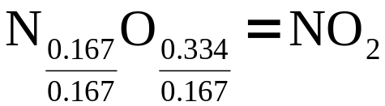
A sample of a brown gas, a major air pollutant, is found to contain 2.34 g N and 5.34g O. Determine a formula for this substance.
require mole ratios so convert grams to moles
moles of N = 2.34g of N = 0.167 moles of N
14.01 g/mole
moles of O = 5.34 g = 0.334 moles of O
16.00 g/mole
Formula:
(HONORS only)

Slide 32
Calculation of the Molecular Formula
(HONORS only)
A compound has an empirical formula of NO₂. The colourless liquid, used in rocket engines has a molar mass of 92.0 g/mole. What is the molecular formula of this substance?

Slide 33
Empirical Formula from % Composition
(HONORS only)
A substance has the following composition by mass: 60.80 % Na ; 28.60 % B ; 10.60 % H
What is the empirical formula of the substance?
Consider a sample size of 100 grams
This will contain 28.60 grams of B and 10.60 grams H
Determine the number of moles of each
Determine the simplest whole number ratio

